Slide 1
FAFSA Simplification
‘Catch-Up’ Session
MAFAA
December 5,2023

Slide 2
Intros
Ali Facklam
University of Minnesota
she/her
Kaity Sharp
University of Minnesota
she/her

Slide 3
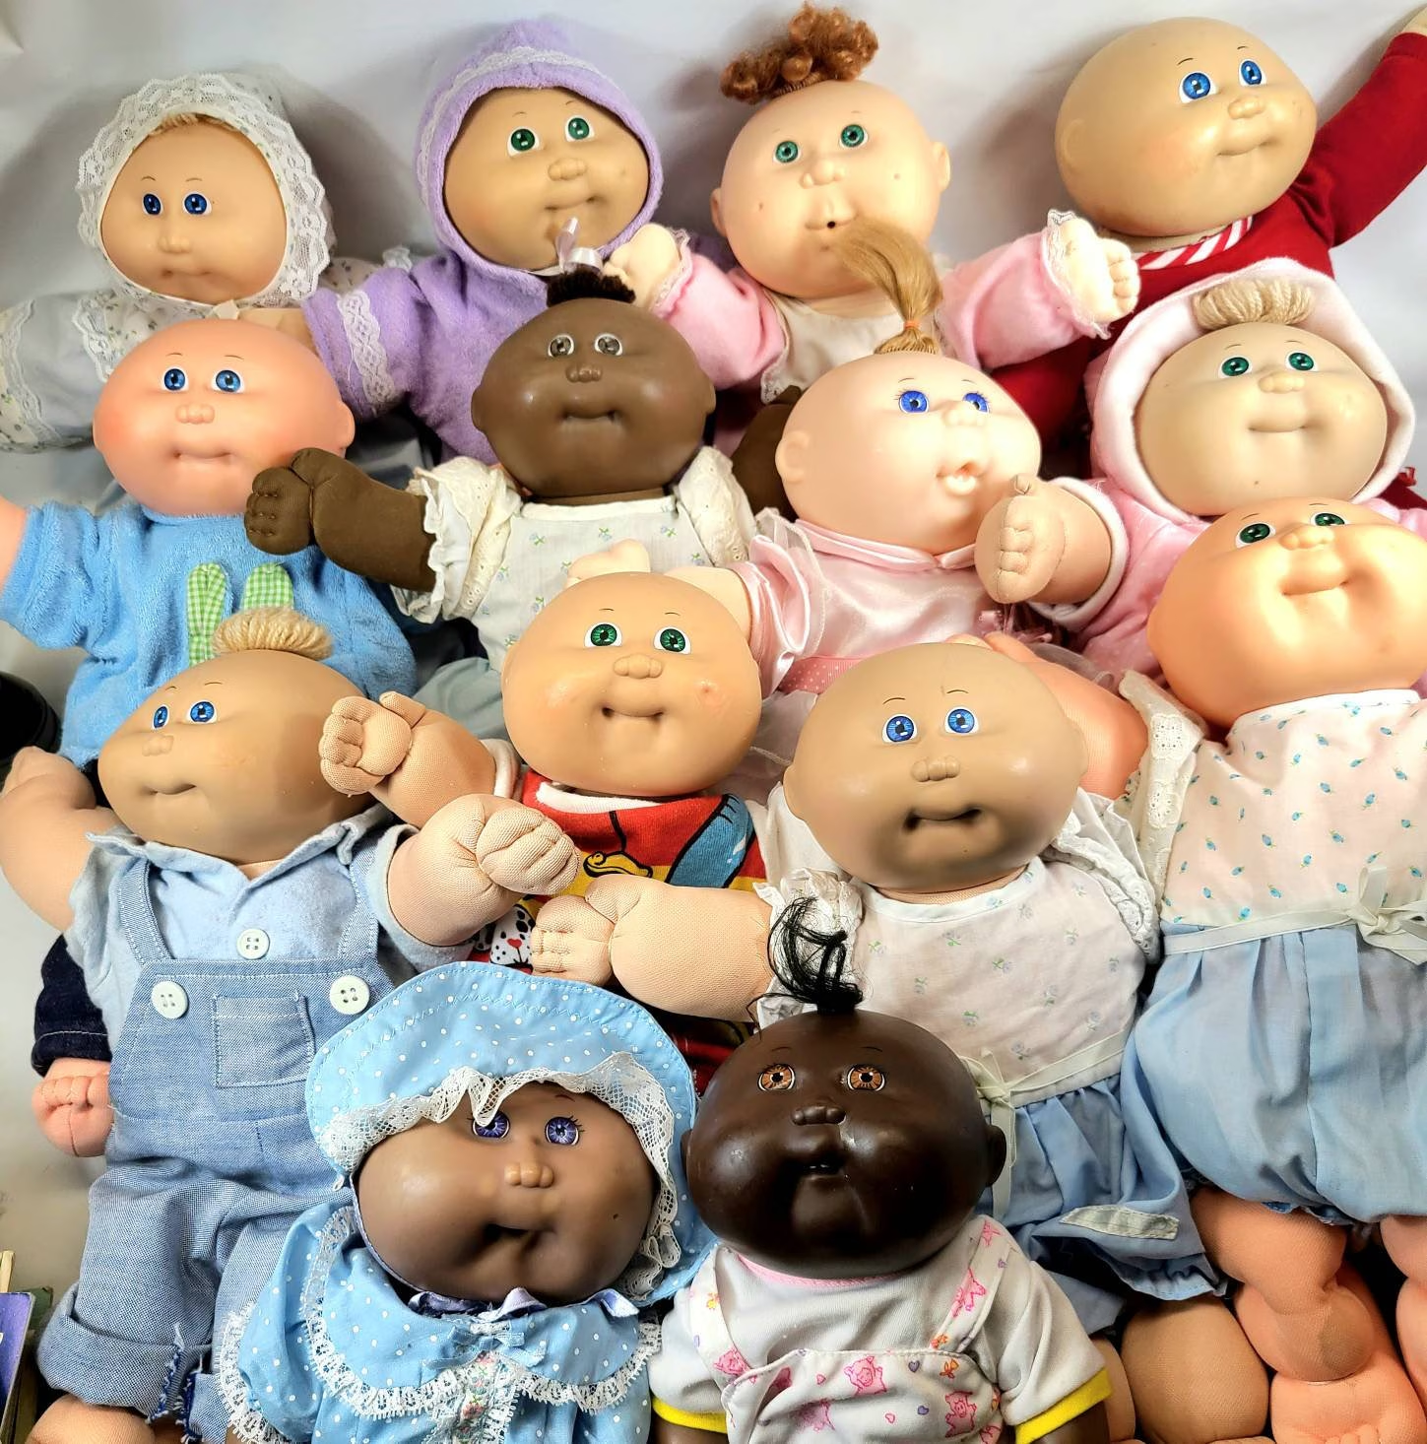
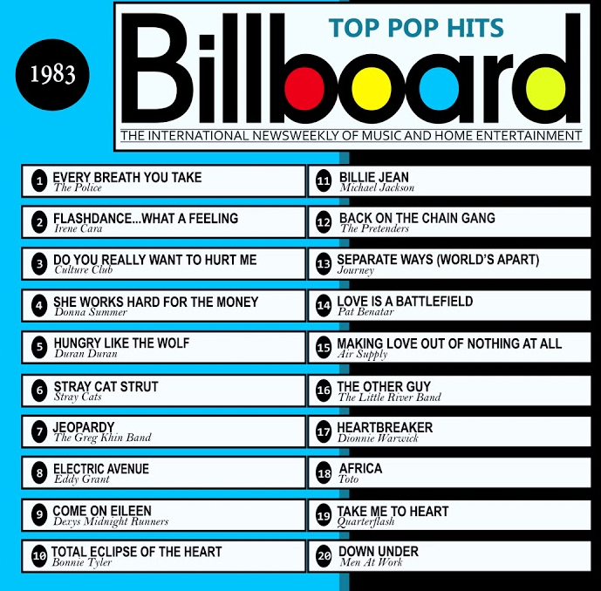
The year was 1983…

Slide 4
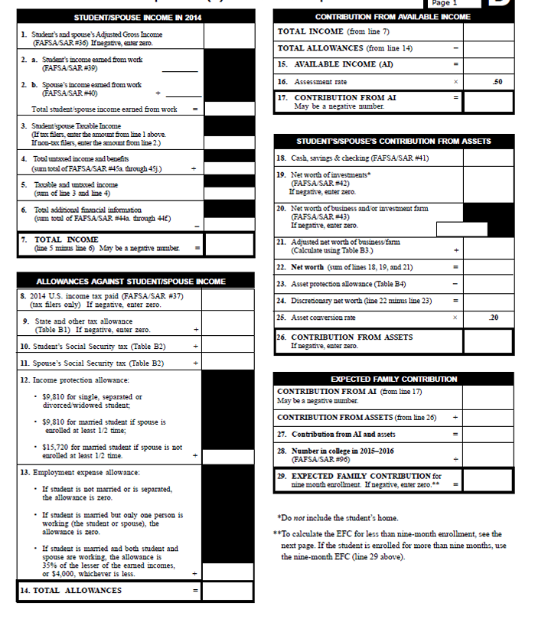
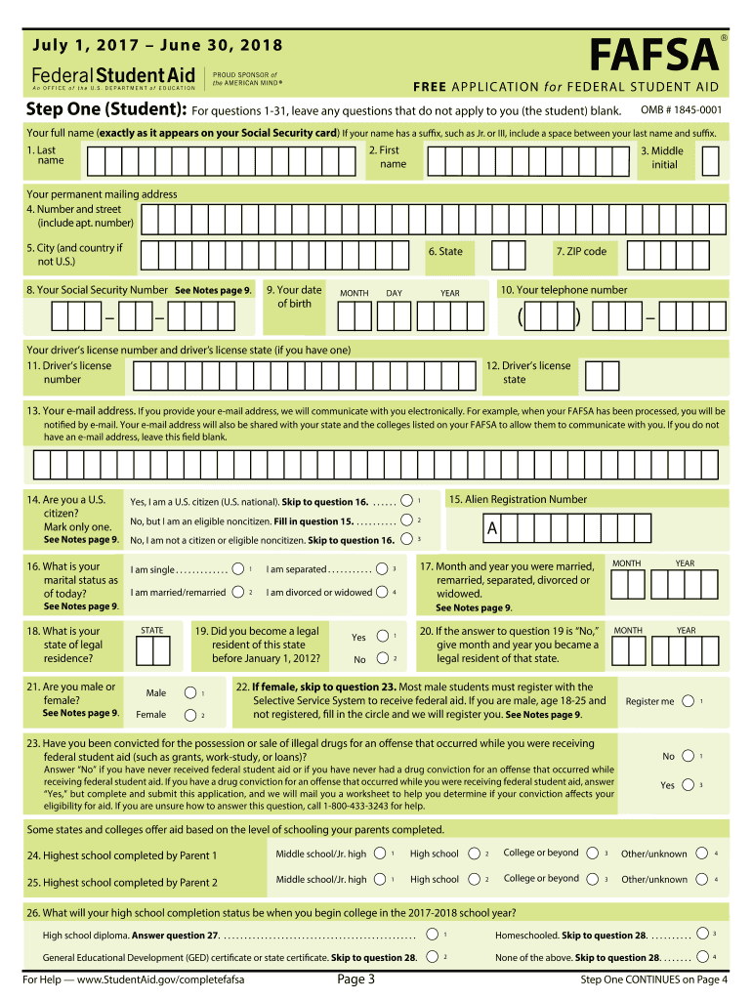
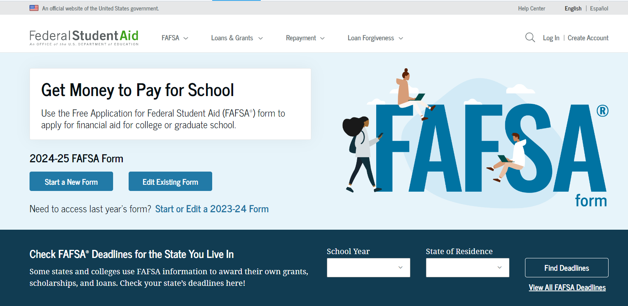
New FAFSA Landing Page

Slide 5
FAFSA Simplification
Simplified form - connected to IRS
Greater data accuracy
Greater transparency in college cost and appeals processes

Slide 6
New Terminology
List of New Terminology (FSA)
Studentaid.gov Account = FSA ID
Applicant = Student
Contributor = typically parent/spouse
FAFSA Submission Summary = SAR
OFA = Other Financial Assistance (previously EFA)
FTI = Federal Tax Information
DDX = Direct Data Exchange
Housing & Food = Room and Board
Provisional Independent status = new status for students under certain conditions

Slide 7
Release Date
Latest update from Dept of Education is “by December 31st” (will return to normal release of October 1st next year)
Schools will begin receiving ISIRs by end of January 2024
Students cannot make corrections until February and schools cannot make corrections until after that
For this year, the delayed release means less time for students/families to complete FAFSA and less time for schools to package aid

Slide 8
StudentAid.gov Accounts
StudentAid.gov Account (FSA ID)
Will be required for all contributors to log into and sign FAFSA
No longer requires an SSN
No more parent signature page
Removed ability to access FAFSA through personal identifiers
Can begin creating accounts now and this is highly encouraged!

Slide 9
Contributors
Contributor - Refers to anyone who is asked to provide information on the student’s FAFSA Form. ie: Parent, Step-Parent, Spouse
Parent Wizard built in to help students identify contributors
Contributor should be parent who provides more financial support (no longer who student lives with more)
‘Expiration’ dates
Applicant/contributors must sign and submit their sections within 45 days of giving consent
After 45 days of inactivity, FAFSA expires and student will be required to start over

Slide 10
Steps for Contributors
Step 1
Step 2
Step 3
Step 4
Step 5
Receives email informing them they’ve been identified as a contributor.
Creates a studentaid.gov account if they don’t already have one.
Logs in to account using their username and password.
Reviews info about completing their section of the FAFSA and gives consent.
Provides the required information on the student’s FAFSA form.

Slide 11
Consent
Consent for Direct Data Exchange
Required by all applicants and contributors
Essentially terms of service agreement
Consent must also be given by those who:
Enter in tax information manually
Did not work/file taxes
If consent is not given at any point, the student will not be eligible for federal student aid
Can make corrections if they did not originally provide consent

Slide 12
Student Questions Removed
Driver’s license number/state
Housing question
Federal work study preference
Taxable earnings from need-based employment
Tax/income questions
Untaxed income not on 1040
Additional financial information
Dislocated worker
Whether or not they filed a schedule 1

Slide 13
Parent Questions
Changed
Number in college
Still asked this year but not used in calculation
Child support received
Now an asset
Removed
Child support paid
Tax/income questions
Untaxed income not on 1040
Additional financial information
Dislocated worker
Whether or not they filed a schedule 1

Slide 14
New Additions
Demographics
Race/Ethnicity/Gender questions
Students will be required to answer questions, but can respond with ‘Prefer not to Answer’
The results of these questions will not be sent to schools - for data collection purposes
Option to add 20 schools (formerly 10)
11 languages (English and Spanish - others over the phone)

Slide 15
Specific Populations
Unaccompanied Homeless Youth
Unaccompanied and 1) homeless or 2) self-supporting and at risk of being homeless
Check determination (designee of homeless youth program, high school counselor, TRIO or GEAR UP director, FAA, or none of the above)
None of the above = provisional independent status
Unusual Circumstances
Student is unable to contact parent/contact poses a risk
Applicants will be granted provisional independent status
Dependency override process
If approved, status will remain independent (as long as circumstances are don’t change)
Unsubsidized Loan Only
Recommended outreach

Slide 16
Unusual vs. Special Circumstances
Unusual Circumstances | Special Circumstances
Student is unable to provide parent information due to unusual circumstances. Examples: Human trafficking Legally granted refugee or asylum status Parental abandonment, estrangement, or abuse Student or parental incarceration | Student or contributor experiences significant changes to their financial situation. Examples: Loss of employment or financial assets Reduction in income Tuition expenses at post secondary school High medical expenses not covered by insurance

Slide 17
DDX and FTI
IRS DRT = Direct Data Exchange (DDX)
No more IRS DRT button/redirect to IRS
The DDX will bring over Federal Tax Information (FTI)
Manual data entry may still be required
FTI is Controlled Unclassified Information (CUI)
HIGHLY protected
Family Size will be transferred

Slide 18
Verification
New Items for Review
Foreign Income Exclusion
Income Earned from Work
Amended Tax Returns (1040X)
Verification of Non Filing (VONF) - BYE!
V4/V5 Statement of Ed Purpose

Slide 19
Student Aid Index (SAI) Formula
Expected Family Contribution (EFC) will now be Student Aid Index (SAI)
Negative SAI (-1,500), treated like a 0 EFC
Number in college still being asked, but not included in SAI calc
Assets will now include:
Child Support Received
Family Farms* and Small Businesses
Does NOT determine Pell Grant amount

Slide 20
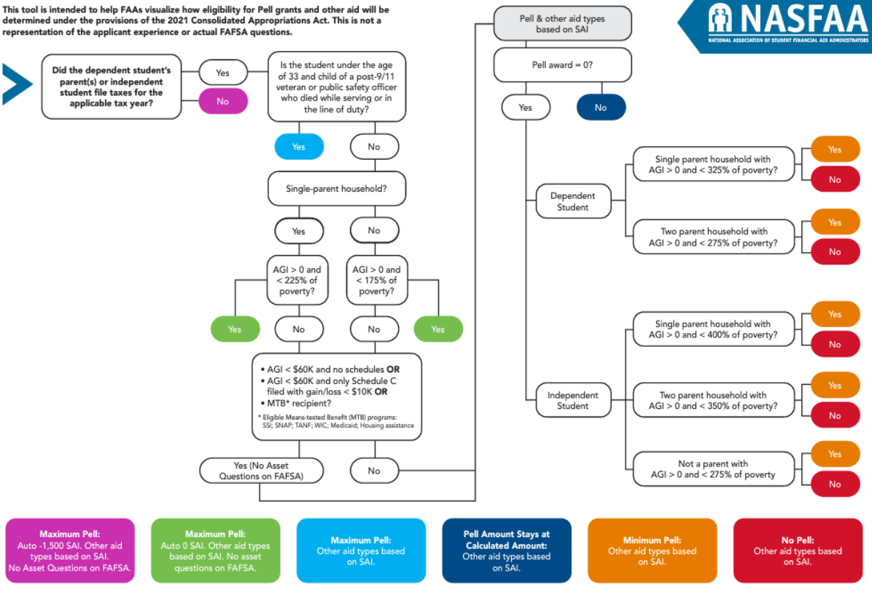

Slide 21
Pell Grant Eligibility
Family should be able to determine their Pell grant amount by answering a few questions
Maximum Pell Grant
Students qualifying for maximum Pell will have an SAI between –1500 and 0. Max Pell based on family size, AGI, poverty guidelines, and tax filing status.
Student Aid Index (SAI)
For students who don’t qualify for max Pell may still be eligible if their calculated SAI is less than the max Pell grant award. (Max Pell - SAI = $$ Pell)
Minimum Pell Grant
Students whose SAI is > max Pell may still be eligible for some amount of Pell based on family size, AGI, poverty guidelines, and tax filing status.

Slide 22
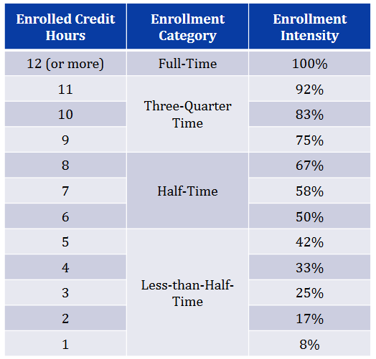
Enrollment Intensity
The FSA amendments require that “awards be reduced in direct proportion to the degree to which the student is not enrolled full-time, rounded to the nearest whole percentage point.”

Slide 23
Miscellaneous Topics
Schools have a new SAIG mailbox
FAFSA Partner Portal (FPP) = FAA Access through CPS
Comment Codes (C Codes) reassigned
Crosswalk document
Independent Student = parent info not required - Loan

Slide 24
Potential Impacts on Campus
Cost of Attendance (COA) changes
Room and Board = Housing and Food
Link to COA Webpage
Housing question was removed - did you use this to determine COA?
Special Circumstances and other appeals
Not much has changed, you can’t deny
Must review within 60 days
Process for provisional independent status
FWS Reporting to COD

Slide 25
Potential Impacts cont.
Campus Partners
Compressed timeline/delay
FTI data sharing limitations
Potential adjustments to institutional aid programs
Student Outreach to special populations

Slide 26
Resources
FAFSA Prototype
List of New Terminology
Federal Aid Estimator
Pell Grant and SAI Process Flowchart

Slide 27
Questions?

