Slide 1
Cost of Attendance
COA
SAI (was EFC)
Pell Eligibility
Gift/Need/non-Need based Aid

Slide 2
Definition:
Cost of attendance (COA) is the amount it will cost a student to go to school. Most two-year and four-year colleges calculate their COA to show the total cost for the school year (fall and spring terms OR three quarters).

Slide 3
Cost of Attendance*: What is included?
Will vary from college to college
Tuition & standard fees charged to all students
Books, supplies and equipment
Food & Housing
Transportation (school & work)
Personal Expenses
Loan Fees

Slide 4
Student Aid Index - SAI (formerly EFC)
The SAI is an index number used to determine eligibility for federal student financial aid (not Pell Grants). This number results from the information provided on a student’s Free Application for Federal Student Aid (FAFSA) form.
The SAI is calculated according to a formula established by law and considers the family’s income and assets.
Schools use SAI to determine federal loan and work study eligibility. Is sometimes used to determine Pell Grant eligibility.

Slide 5
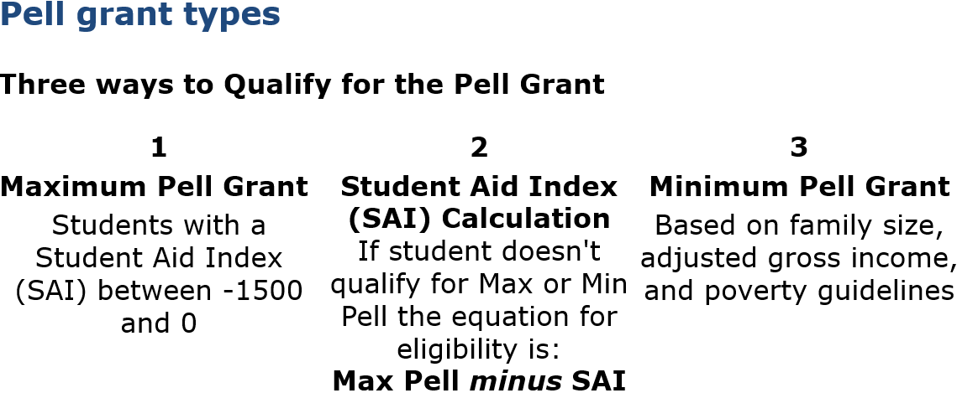

Slide 6
Summary of Financial Need - This is how it all comes together!
COA – SAI – Gift/Scholarship $$ = Financial Need
Need-based aid is financial aid that a student can receive if they have financial need and meet other eligibility criteria. A student can’t receive more need-based aid than the amount of their financial need.
For instance, if the COA is $16,000 and the SAI is 12,000, your financial need is $4,000 (pending no other scholarships & Gift Aid); so, this student is not eligible for more than $4,000 in need-based aid.
16,000 – 12,000 – 0 = $4,000

Slide 7
Examples of Gift Aid (Need based Aid)
Minnesota State Grant (will replace negative SAI)
Federal Pell Grant
American Indian Scholars Program

Slide 8
Examples of Need Based Aid
North Star Promise Program
Federal Supplemental Educational Opportunity Grant
Federal Direct Subsidized Loan
Federal & State Work Study

Slide 9
Summary of Non-Need Based Aid
COA – Gift/Need Based Aid = Eligibility for non-Need based Aid
Notice SAI is taken out of the formula.
Non-Need based aid can replace the SAI.

Slide 10
Examples of Non-Need Based Aid
Federal Direct Unsubsidized Loan
Private Loans
Parent PLUS Loan
Graduate PLUS Loan
Scholarships
Campus funded Work Study

Slide 11
Questions?

