Slide 1
Financial Wellness
Location
Date
Presenter, School/Company
Presenter, School/Company

Slide 2
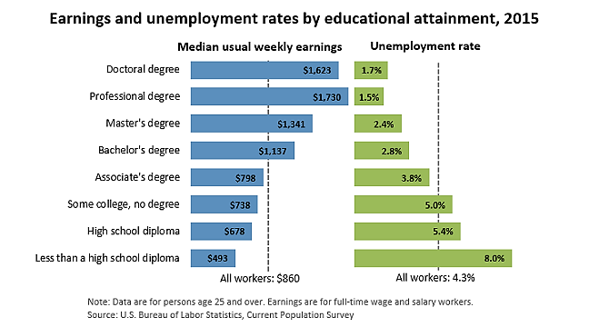
A Wise Purchase
Presenter, School/Company & Presenter, School/Company
Notes:
Think about wise purchases you have made. Now think about this: Your college career could be one of your most expensive purchases; likely second in cost to a future mortgage. But, like a home, it will also be one of your greatest investments.

Slide 3
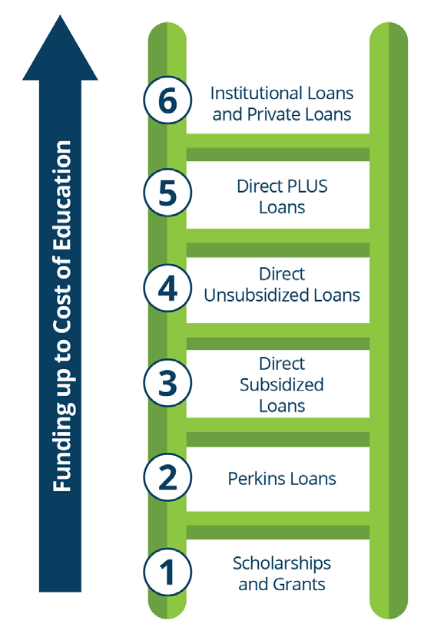
Ladder of Smart Borrowing
Options for the Smart
Borrower
(2016, Great Lakes Higher Education Corporation)
Presenter, School/Company & Presenter, School/Company
Notes:
When it comes to paying for college, students have a lot of options. If grants and scholarships do not cover the cost of education, students may need to consider loans.
Depending on a student’s individual financial situations, some options make more sense than others.
It can be helpful to think of financing an education in terms of a ladder: Students can start with the options that will cost them the least, and then proceed to work their way up the ladder (2016, Great Lakes Higher Education Corporation).

Slide 4
Education Funding Plan
Free google images
Cost of Attendance (Tuition and Fees, Room and Board, Books etc.)
2. Family Savings and Resources (Parent Savings,Student Savings and Income)
3. Non-Loan Aid (Grants, Scholarships, Outside Gift Aid and Work Study)
4. Federal and Institutional Student Loans (Direct Subsidized,Unsubsidized, Perkins and Institutional)
5. Financing the Gap = Your Total Cost* - Resources - Non-Loan Aid - Student Loans
*Your total cost may be a bit different than your school’s cost of attendance (COA); school’s COA build on specific number of credits, and room and board plan, which may differ from your enrollment and/or housing contract.
Presenter, School/Company & Presenter, School/Company
Notes:
When financing the gap you will want to subtract YOUR total cost for tuition and fees, room and board, books, transportation, personal expenses, etc from your anticipated personal payments and non loan-related aid first before applying for loans. Using this equation will give you an idea of how much you need to borrow in loan funding, so you do not borrow more than you need.
Stick to borrowing federal and institutional student loans before alternative loans, such as a parent loan or private student loan, which may carry loan fees and higher interest rates.

Slide 5
Know the Federal Direct Loan Limits
Federal Subsidized Student Loan
(up to- depending on need)
$3500 (Freshman)
$4500 (Sophomore)
$5500 (Junior/Senior)
Federal Unsubsidized Student Loan
$2000 (Freshman-Senior)
Totals:* https://www.nslds.ed.gov/nslds/nslds_SA/
$5500 (Freshman)
$6500 (Sophomore) Stay informed. Know how to access and view your direct loan borrowing history.
$7500 (Junior/Senior)
*Totals shown are based on a dependent student status.
Add an addional $4000 in unsubsidized loan funding for an independent student.
Graduate students are only eligible for unsubsidized loan funding, including federal unsubsidized student loans, Grad PLUS loans,
and loans offered through private lenders.
Presenter, School/Company & Presenter, School/Company
Notes:
Borrowing money is necessary for some of us to achieve our goals. Things like owning a home or completing an education are made possible through loans.

Slide 6
Small Things Add Up
Start to think about repayment:
For every $10,000 borrowed, repayment will be
approximately $100/month over a standard 10-year
repayment.*
Get an Estimate. Use the Repayment estimator on
https://studentloans.gov
Free Google Images
Presenter, School/Company & Presenter, School/Company
Notes:
*Assuming a fixed, 5% interest rate
Live like a student now so you don’t have to later. New college students, especially those living in the dorms and newly emancipated from home, are more financially independent than ever. Spending choices become habits. Now is the time to live simply. Many times students identify with the idea of being poor, however, if we inventoried their things, we would find that they’re not living poorly or below their means. Under no circumstances should financial aid (loans) be used to finance anything except educational expenses. This does not include clothing or spring break.

Slide 7
Rules of Borrowing
Use free money (scholarships and grants) and don’t borrow at all
Seek scholarship opportunities through community and college resources
Borrow as little as possible
Borrow only to cover direct costs (tuition, fees, books, supplies)
Pay your loan interest while you are in school
Work to pay for all indirect costs as you go along
Presenter, School/Company & Presenter, School/Company
Notes:
Build awareness of what you can handle after graduation – what other ways can you finance your education other than loans?
For those who use any kind of aid – such as loans:
•Remember to think about how much you take before you click accept. You are not required to take out every cent offered in loans. Figure out a budget and only take what you need.
•Decline the loans that you do not need. You will not be offered less the next year if you say no to a loan.
•Try to pay with free money, help from family, savings, work, or scholarship opportunities if possible. ***Check out your high school and local community foundations for great scholarship opportunities; put in your time applying for these scholarships, because think about it- if you spend an hours worth of your day applying for a $1000 scholarship and receive it, you have just made $1000 in one hour.***
•Figure out, based on your starting salary, how much you should be getting total and how much annually that will equal.
•Make sure all charges are paid for on your account before you use your financial aid refund. Check your student account to ensure all charges are paid, especially things like bookstore charges which aren’t necessary going to be automatically paid by your financial aid disbursement.

Slide 8
Mistakes
Using loan refunds to pad your bank account
Using loans to finance spring break, clothes, coffee shop visits, or the best
laptop
Using loans to inflate lifestyle
Premium housing
Technology
Keeping up with the Jones’
Free google images
Presenter, School/Company & Presenter, School/Company
Notes:
•Aim to graduate in four years-work and work with your Academic Advisor
•Save $
•Budget your living expenses
•Use loan money wisely (Not for Spring Break)
•Know your future salary
•Know your debt load
•Be smart about changing your major

Slide 9
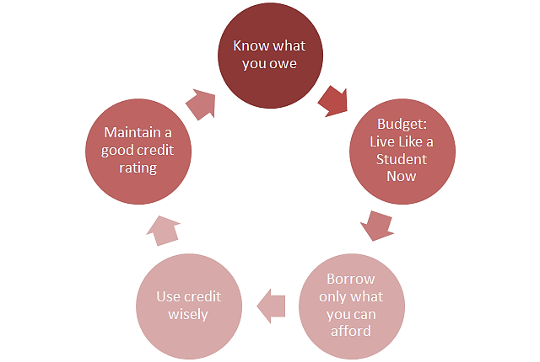
Rules for Debt Management
Presenter, School/Company & Presenter, School/Company
Notes:
When it comes to borrowing for school, be active and involved. Know what you owe and live simply. Educating yourself and being mindful of where your money is going will allow you to be successful in the rest of your life. Otherwise, student loan and credit card debt could exceed what you’re able to manage. There is such thing as an unmanageable amount of student loan debt!

Slide 10
What is a GOOD credit score?
Presenter, School/Company & Presenter, School/Company
Notes:
Make sure to maintain a good credit score. You can check your report annually through various credit reporting sites such as annualcreditreport.com or creditkarma.com. These sites will allow you to retrieve your credit score free of charge, and are a great resource for catching identity theft.
While some alternative loan lenders will require that a prospective borrower and/or cosigner have a credit score of at least 720 to in order to get approved, there are others that require a minimum FICO credit score of at least 640 to improve chances of approval.
A credit check will be performed during the application process of an alternative loan. Since you are applying for a loan, a hard inquiry to your credit report will occur. Hard credit inquiries can lower a credit score by a few points, thus negatively affecting your overall credit score. It is for this reason that students are suggested to not only borrow as few loans as possible, but also borrow as few times as possible.

Slide 11
What other financial resources should I use?
Pre-College Savings
Every dollar saved before college can save you dollars after college in the form of reduced interest payments
WORK during summers and break!
Think about PSEO or College in the Schools
Graduate on time for the best value
Current earnings
Working while in college should not be seen as optional
Set up a payment plan instead of applying for a loan to pay off educational expenses
Future earnings (student loans)
For education-related expenses only
Presenter, School/Company & Presenter, School/Company
Notes:
Now that we have confirmed a college education is a wise purchase, and learned how to be a smart borrower by talking about the rules of borrowing and mistakes that can easily be made, how can you afford college?

Slide 12
Putting it all into Perspective!
Game of Life:
Congratulations, you have just received a 4-year degree. You have accepted a position in Minnesota making an annual GROSS salary of $47,000. After 22% is taken from your GROSS earnings for taxes, here is your BIG picture:
Your monthly earning, after taxes, is $3,000 (NET pay)
Mortgage (includes home owners ins) = $1,000 *If we take your monthly income and subtract all
Car payment = $250 payments necessary to live this lifestyle, you would have
Student Loan payment = $300 an extra $305 a month (or about $75 a week) to live
Utilities (electricity, heat, water) = $270 on. Keep in mind none of the tallies to the left include
Garbage = $75 cost for groceries, toiletries, transportation costs (gas), Cell Phone = $150 entertainment, etc.
Internet/TV = $100 Credit Card payment = $100
Insurance (health, dental) = $340
Car Insurance = $110
(Amounts listed above are based on average monthly payments you would make living in Minnesota)
Presenter, School/Company & Presenter, School/Company
Notes:
Since your student loan payment is $300 a month, it suggests you did borrow $30,000 in total loan funding during your college career. Your repayment plan is based on a standard, 10-year payment plan.

Slide 13
Summary
College is a wise purchase
Borrow Smart: utilize non loan-related funds to finance your education first to minimize loan borrowing
Know what you have borrowed, and start thinking about repayment
Don’t make the mistake of borrowing loans to live an elaborate lifestyle
Understanding good credit and how it relates to loan borrowing
Live like a student now so you do not have to later!
Presenter, School/Company & Presenter, School/Company
2016- 2017

Slide 14
Scholarship Search Websites
https://studentaid.ed.gov/sa/types/grants-scholarships/finding-scholarships
http://www.ohe.state.mn.us/sPages/scholarshipsAll.cfm
https://www.fastweb.com
https://scholarshipamerica.org
https://bigfuture.collegeboard.org/scholarship-search
http://www.ncaa.org/gsearch/scholarships

Slide 15
References
Check your financial literacy. (2016). CaféCredit. Retrieved from https://www.cafecredit.com/credit-score-range/
Earnings and unemployment rates by educational attainment. (2015). U.S. Bureau of Labor Statistics. Retrieved from http://www.bls.gov/emp/ep_chart_001.htm
Education funding plan. (2016). Great Lakes Higher Education Corporation and Affiliates. Retrieved from https://gradready.com/gradreadystatic/forms/GR008_EFP.pdf
Federal student loans for college or career school are an investment in your future. (2016). Federal Student Aid (An office of the U.S. Department of Education). Retrieved from https://studentaid.ed.gov/sa/types/loans
Ladder of smart borrowing. (2016). Great Lakes Higher Education Corporation and Affiliates. Retrieved from https://gradready.com/gradreadystatic/forms/GR007_Ladder-of-Smart-Borrowing.pdf
Live Like A Student. (2013). University of Minnesota, Duluth. Retrieved from http://www.d.umn.edu/llas/
NSLDS student access. (2016). Federal Student Aid (An office of the U.S. Department of Education). Retrieved from https://www.nslds.ed.gov/nslds/nslds_SA/
Pechinski, N. (2016, September 28). Personal interview.
Repayment estimator. (2016). Federal Student Aid (An office of the U.S. Department of Education). Retrieved from https://studentloans.gov/myDirectLoan/repaymentEstimator.action

Slide 16
Presenter, School/Company, Email
Presenter, School/Company, Email
2016- 2017

Slide 17
Thank you!

